Slide 1



Divorce Prediction
DSC680 – Project 2
Rohan Valder

Slide 2


Presentation Overview
Project Details
Mean Score By Attribute
Heatmap Correlation
Features Correlated with Class
Top 5 features
Conclusion
References

Slide 3
Project Details
Dataset Link: https://archive.ics.uci.edu/ml/machine-learning-databases/00497/
Dataset Information: The dataset used is retrieved from UCI Machine Learning Repository. With Dr.Gottman in mind, researchers responded to 54 statements to find out their views on the spouse, ex-spouse, and the relationship. The results were responses of 170 individuals, which consisted of married and divorced participants.

Slide 4
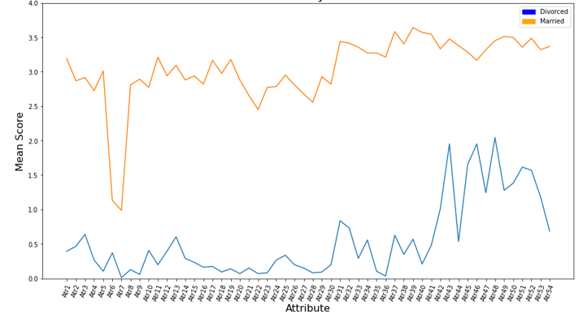
Mean score by attribute

Slide 5
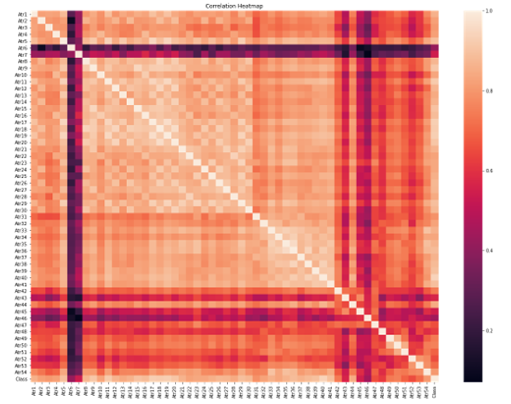
Heatmap Correlation

Slide 6
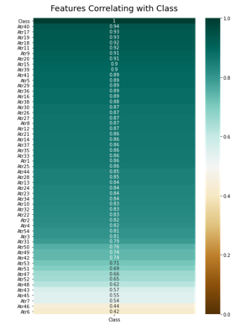
Features correlated with class

Slide 7
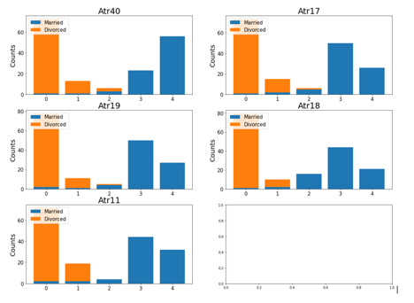
Top 5 features

Slide 8
Conclusion
98% accuracy is the best I could achieve. The one mistake could be considering the married individual as divorced. There are many reasons this mistake would have happened. Perhaps the individual scored negative, regardless of the feelings, the person was still married. This would not be an odd situation, as the person would be unhappy but still married for religious beliefs, for the kids, or the cultural reasons. The participants of the dataset were from Turkey and 96 out of the 170 respondents had an arranged marriage. Achieving 98% is amazing but trying to get 100% is naïve. Accuracy could be better by having more observation on religion, children, arranged marriage, etc.

Slide 9
References
- Nurdialit, Dwi Gustin (2020, September). Netflix Movies and TV Shows — Exploratory Data Analysis (EDA) and Visualization Using Python. - https://medium.com/analytics-vidhya/netflix-movies-and-tvshows-exploratory-data-analysis-eda-and-visualization-using-python-80753fcfcf7
- Pradhan, Karan (2021, July). Visualizing Netflix Data Using Python! - https://www.analyticsvidhya.com/blog/2021/07/visualizing-netflix-data-using-python/
- Ramos, Leodanis Pozo (2022, Feb). Python's zipfile: Manipulate Your ZIP Files Efficiently - https://realpython.com/python-zipfile/
- Ebrahim, Mokhtar (2022, Feb). Python time module (Simple Examples) - https://likegeeks.com/python-time-module/

